Slide 1


Noser E-DAYS Securing .NET Core, ASP.NET Core applications
Damien Bowden
https://damienbod.com
@damien_bod

Slide 2
Application Security today
OpenID Connect, OAuth

Slide 3
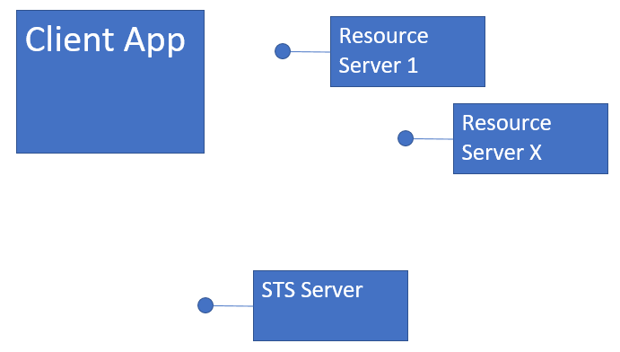


HTTPS everywhere, Certs
Protected Zone
WAF

Slide 4
HTTPS everywhere, Certs
Protected Zone
WAF

Slide 5
Security in applications
Authentication, Authorization, Accounting
Session Protection HTTP headers
HTTPS Certificates TLS 1.2, 1.3
WAF Web Application Firewall
GDPR, Data breaches
Hosting

Slide 6
ASP.NET Core solutions
Authentication, Authorization, Accounting
Session Protection HTTP headers
HTTPS Certificates TLS 1.2, 1.3
WAF Web Application Firewall
GDPR, Data breaches
Hosting

Slide 7
Authorization
Authentication
Session
Signout
Notes:
User with client => Identity

Slide 8
USE Standards
Don’t implement this yourself, use certified libs, packages, tested

Slide 9


Authentication
Authorization
Delegation

Slide 10
OpenID Connect
https://openid.net/connect/
Standard, Specification
Authentication and Authorization
built on top of OAuth2 (access control)
Identity (Person can have n Identities)
UserInfo Endpoint

Slide 11
Open ID Connect (OIDC) is supported by almost all systems
Azure AD, Azure B2C
Auth0, OKTA
Openiddict
Duende IdentityServer
google accounts
node-oidc-provider
Keycloak

Slide 12
Authorization
Authentication
Session
Signout

Slide 13

OpenID Connect, OAuth
Notes:
Explain one stop apps, reusing company AAA

Slide 14
OpenID Connect Flows OAuth2 Flows http://openid.net/specs/openid-connect-core-1_0.html
OAuth2 Resource Owner Credentials Flow
OpenID Connect Code flow + PKCE with client secret
OpenID Connect Hybrid flow
OpenID Connect Code flow + PKCE with no secret
OAuth Device Flow
On Behalf Of (OBO) Flow
Azure Managed Identities
Notes:
15 mins
Protected, trusted applications question

Slide 15
id token token (access token) reference / self contained token refresh token
scope Back-Channel Front-Channel User Agent
Notes:
id_token
Identity token for the Application
Validated, opened by Client Application
not to be used for API access
access _token
access token for APIs, Resources
Not opened, by Client Application
Implicit validation on Client using the at_hash
To be used for API access, resources.
Can by any format, not just a JWT
reference _token
random string, no defined format
references an access_token
easy to control the lifecycle
makes it possible that access_token must never leave the safe zone
refresh token
random string, no defined format
Used to refresh the tokens
Not Implicit Flow
Scope
Identity scopes
API or Resource scopes
managing your claims, grouping, APIs
OpenID scopes openid, profile, email, phone

Slide 16
OAuth2 Resource Owner Credentials Flow
MC to MC applications
trusted client
grant_type=client_credential&client_id=xxxxxxxxxx&client_secret=xxxxxxxxxx
Limited user cases

Slide 17
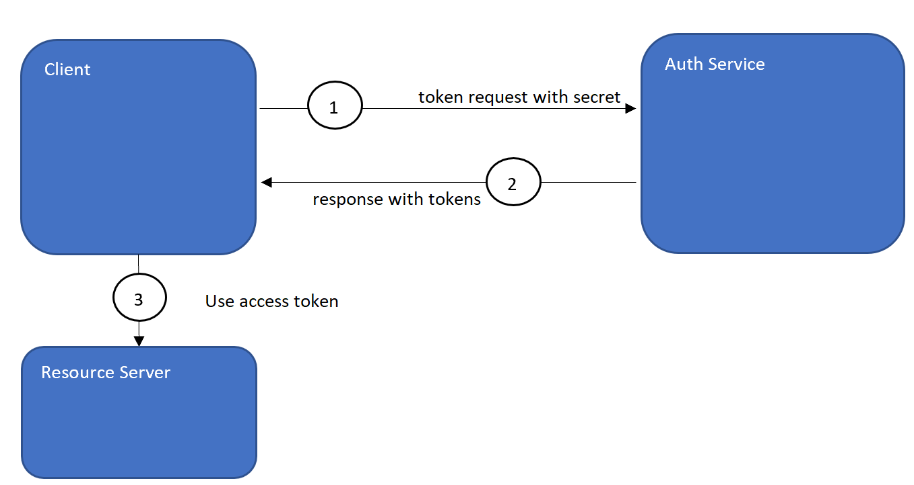
OAuth2 Resource Owner Credentials Flow

Slide 18
OpenID Connect Authorization Code flow + PKCE + secret
Server to server applications with User
Can keep secrets, is trusted
Client is authenticated
response_type = code

Slide 19
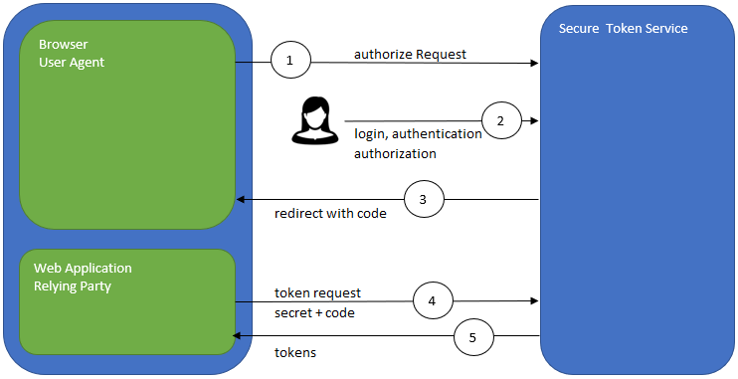
OIDC Authorization Code flow
Notes:
The Authorization Code Flow returns an Authorization Code to the Client, which can then exchange it for an ID Token and an Access Token directly. This provides the benefit of not exposing any tokens to the User Agent and possibly other malicious applications with access to the User Agent. The Authorization Server can also authenticate the Client before exchanging the Authorization Code for an Access Token. The Authorization Code flow is suitable for Clients that can securely maintain a Client Secret between themselves and the Authorization Server.
Steps:
Client prepares an Authentication Request containing the desired request parameters.
Client sends the request to the Authorization Server.
Authorization Server Authenticates the End-User.
Authorization Server obtains End-User Consent/Authorization.
Authorization Server sends the End-User back to the Client with an Authorization Code.
Client requests a response using the Authorization Code at the Token Endpoint.
Client receives a response that contains an ID Token and Access Token in the response body.
Client validates the ID token and retrieves the End-User's Subject Identifier.

Slide 20
OIDC Hybrid flow
Mix of the Code and Implicit Flow
Can be used for Web applications with server side rendering.
response_type = code id_token | code id_token token | code token

Slide 21
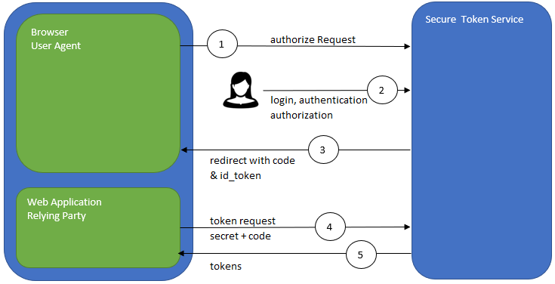
OIDC Hybrid flow
Notes:
http://openid.net/specs/oauth-v2-multiple-response-types-1_0.html
Steps:
Client prepares an Authentication Request containing the desired request parameters.
Client sends the request to the Authorization Server.
Authorization Server Authenticates the End-User.
Authorization Server obtains End-User Consent/Authorization.
Authorization Server sends the End-User back to the Client with an Authorization Code and, depending on the Response Type, one or more additional parameters.
Client requests a response using the Authorization Code at the Token Endpoint.
Client receives a response that contains an ID Token and Access Token in the response body.
Client validates the ID Token and retrieves the End-User's Subject Identifier.
code token
When supplied as the value for the response_type parameter, a successful response MUST include an Access Token, an Access Token Type, and an Authorization Code. The default Response Mode for this Response Type is the fragment encoding and the query encoding MUST NOT be used. Both successful and error responses SHOULD be returned using the supplied Response Mode, or if none is supplied, using the default Response Mode.
code id_token
When supplied as the value for the response_type parameter, a successful response MUST include both an Authorization Code and an id_token. The default Response Mode for this Response Type is the fragment encoding and the query encoding MUST NOT be used. Both successful and error responses SHOULD be returned using the supplied Response Mode, or if none is supplied, using the default Response Mode.
id_token token
When supplied as the value for the response_type parameter, a successful response MUST include an Access Token, an Access Token Type, and an id_token. The default Response Mode for this Response Type is the fragment encoding and the query encoding MUST NOT be used. Both successful and error responses SHOULD be returned using the supplied Response Mode, or if none is supplied, using the default Response Mode.
code id_token token
When supplied as the value for the response_type parameter, a successful response MUST include an Authorization Code, an id_token, an Access Token, and an Access Token Type. The default Response Mode for this Response Type is the fragment encoding and the query encoding MUST NOT be used. Both successful and error responses SHOULD be returned using the supplied Response Mode, or if none is supplied, using the default Response Mode.

Slide 22
Native App / SPA Authorization Code Flow + PKCE
RFC 7636
No secret for public clients
https://tools.ietf.org/html/rfc7636

Slide 23
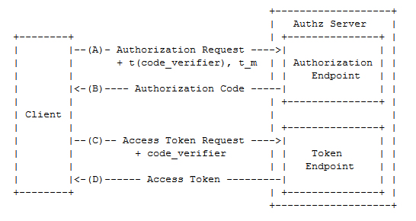

Slide 24
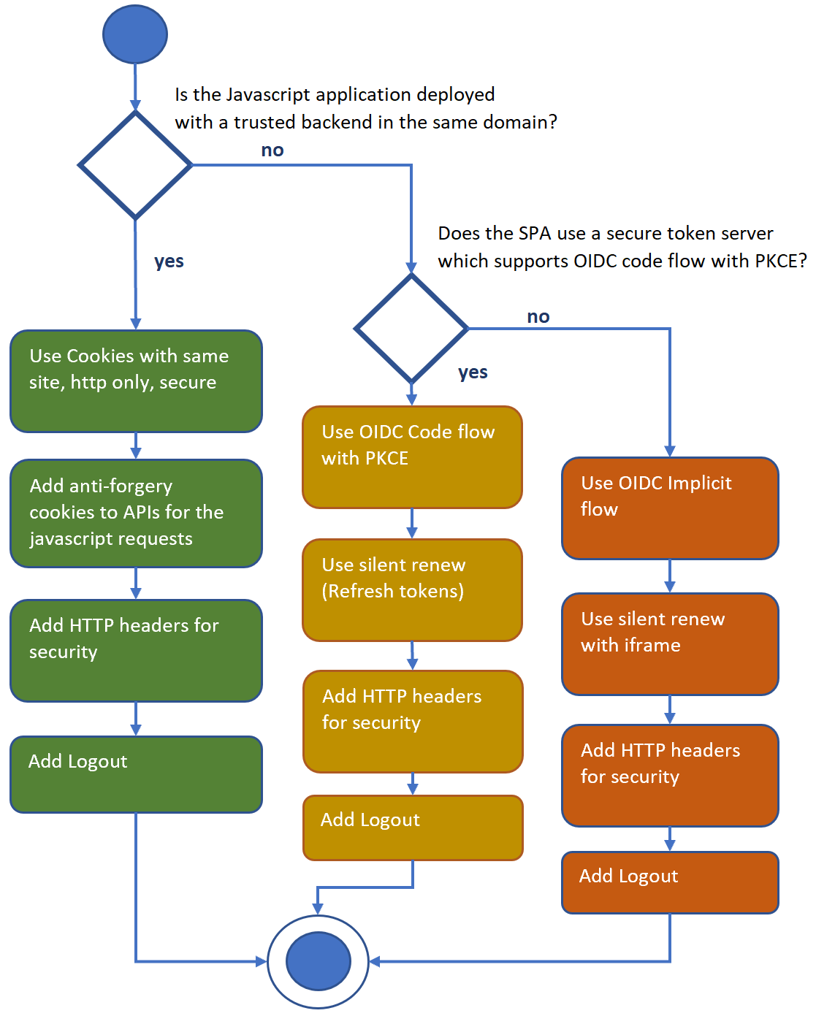
Single Page Applications
Cookies
OIDC Code Flow with PKCE
OIDC Implicit Flow

Slide 25
OpenID Connect Code flow with PKCE
For browser applications, SPAs
Client is not authenticated, or trusted
response_type = code
NO SECRET
Use reference tokens if possible
When using Refresh tokens, check that the STS supports the latest fixes,
Use Revocation!

Slide 26
Difference between Native APPS and SPA
Native apps use different Redirect URLs
Storage for persisting tokens is different
Native app opens a browser to authenicate
Refresh tokens stored in the browser (or silent renew ...)

Slide 27
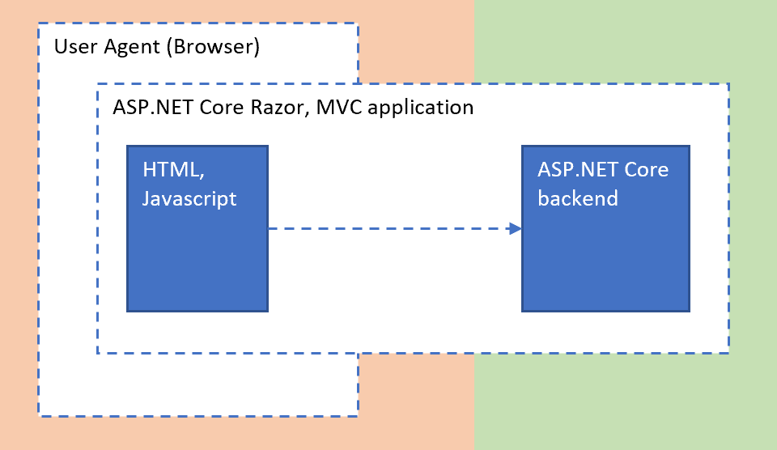

Slide 28
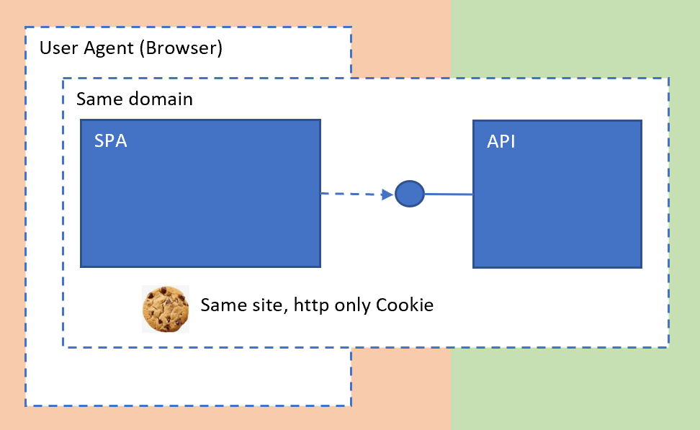

Slide 29
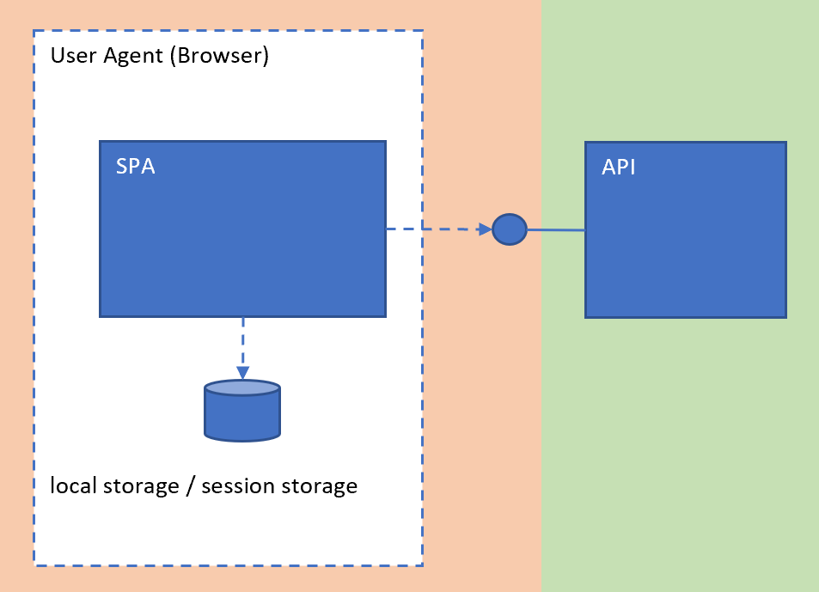

Slide 30
OAuth Device Flow
RFC 7636
https://tools.ietf.org/html/draft-ietf-oauth-device-flow-12

Slide 31
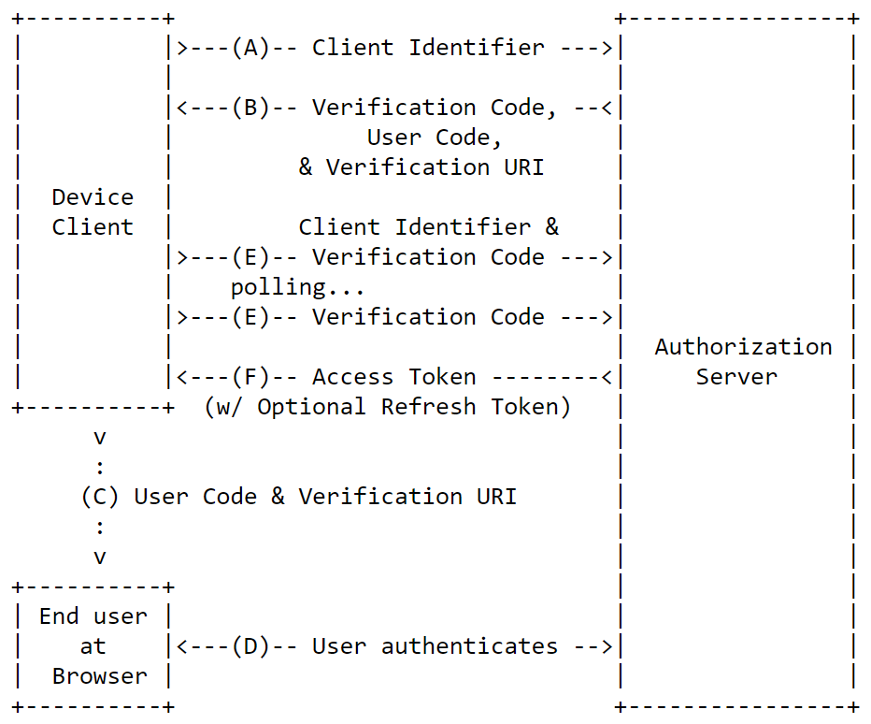

Slide 32
OAuth On Behalf of OBO Flow
- RFC 6749
https://tools.ietf.org/html/rfc6749
https://docs.microsoft.com/en-us/azure/active-directory/develop/v2-oauth2-on-behalf-of-flow

Slide 33
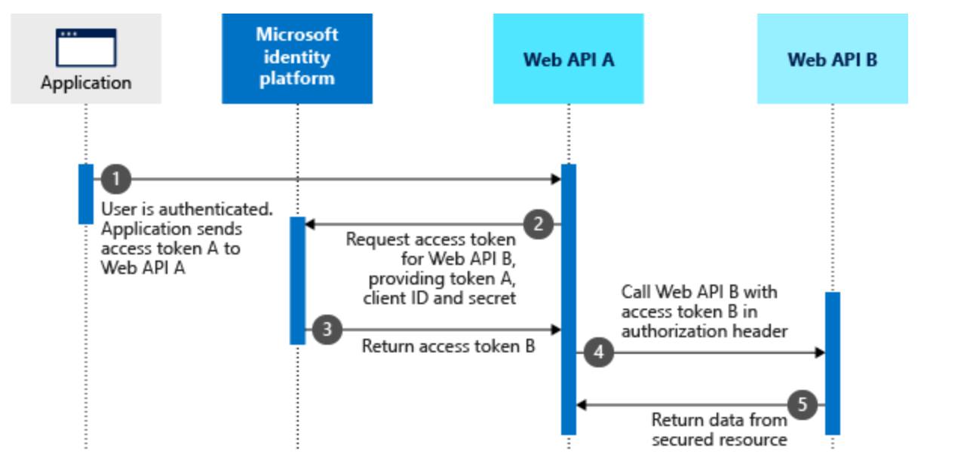
src: https://docs.microsoft.com/en-us/azure/active-directory/develop/v2-oauth2-on-behalf-of-flow

Slide 34

Azure Managed identities
Service to service
Service assigned Managed Identity
User assigned Managed Identity
Is a service principal or built using SPs

Slide 35
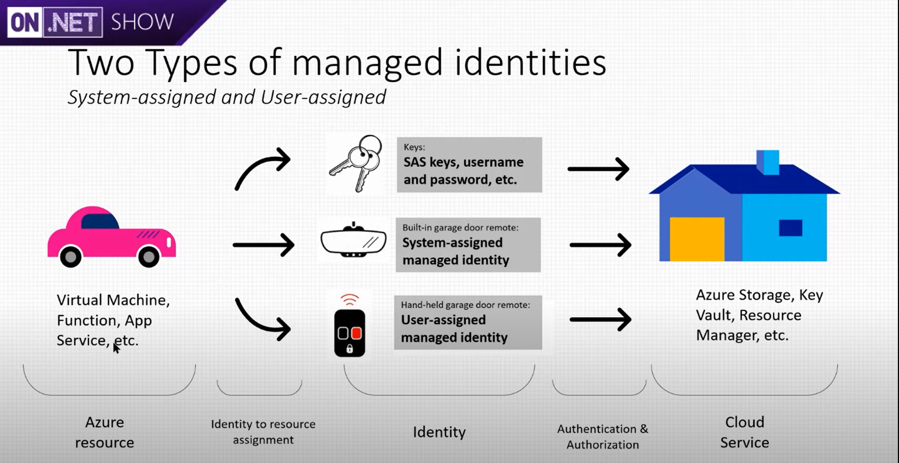
src: https://www.youtube.com/watch?v=vYUKC0mZFqI

Slide 36
Examples
https://github.com/damienbod
https://damienbod.com

Slide 37
Other security solutions of interest
FIDO2
Self Sovereign Identity, Azure AD verifiable credentials
Certificate authentication
OpenID Connect FAPI , Open banking
Azure AD Continuous Access evaluation, OpenID Connect Shared Signals and Events

Slide 38
Thank you @damienbod

